Slide 1
Text Mining II: Mining Quality Phrases
Jiawei Han
Computer Science
University of Illinois at Urbana-Champaign
May 16, 2025

Slide 2
Outline
Why Mining Structures from Massive Text Data?
Text Preprocessing
Mining Quality Phrases: Motivation and Families of Methods
Supervised Approach
Unsupervised Approach (ToPMine)
Weakly Supervised Approach (SegPhrase)
Distantly Supervised Approach (AutoPhrase)
Summary

Slide 3
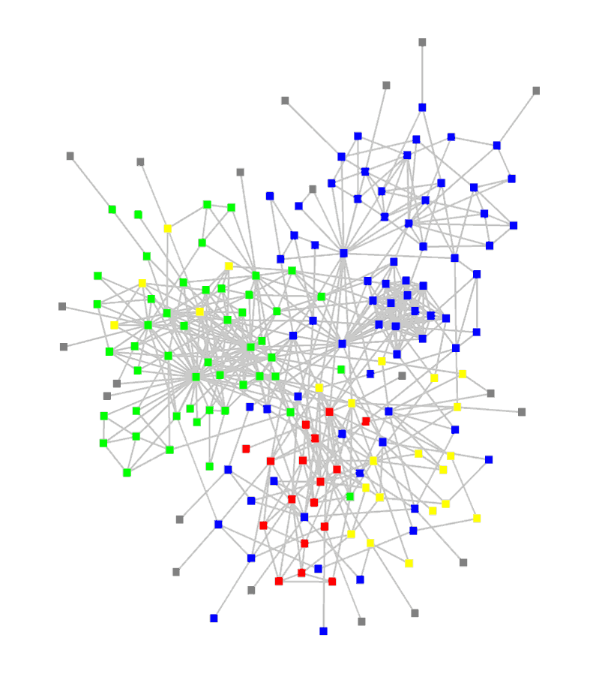
Why Mining Structures from Massive Text Data?
The major challenge for data scientists of our time
The Data-to-Knowledge (D2K) challenge
Big Data: Over 80% of our data is from text/natural language/social media, unstructured, noisy, dynamic, unreliable, …, but interconnected!
Keys from big data to big knowledge:
Structuring (i.e., transforming unstructured text into structured, typed, interconnected entities/relationships)
Networking (take advantage of massive, structured connections)
Mining/reasoning (e.g., induction/deduction) effectively on massive, relatively structured, interconnected networks
D2K game → D2N2K (Data to Network to Knowledge) game
→ Construction and mining of typed, heterogeneous information networks

Slide 4
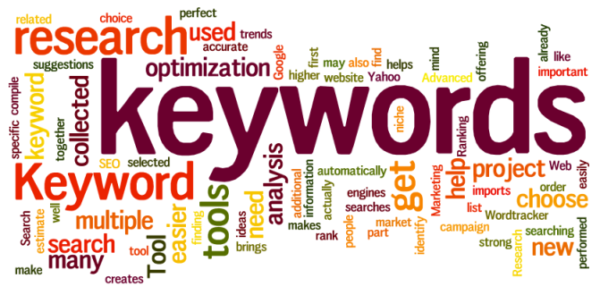
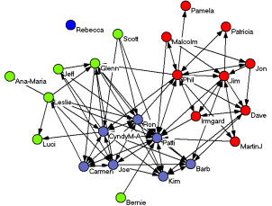






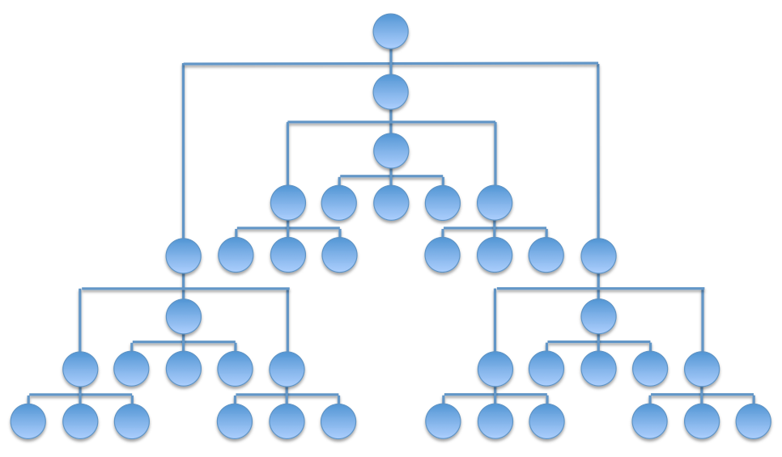


Roadmap: Mining Hidden Structures from Text Data
One of the most challenging issue at mining big data: structuring and mining text!!
Bottleneck: How to automatically generate structures from text data?
Automated mining of phrases, topics, entities, links and types from text corpora
Heterog. networks
Text Corpus
Phrases
Knowledge
General KB
Typed entities/relations/taxonomies
Multi-dimensional Cubes

Slide 5
Outline
Why Mining Structures from Massive Text Data?
Text Preprocessing
Mining Quality Phrases: Motivation and Families of Methods
Supervised Approach
Unsupervised Approach (ToPMine)
Weakly Supervised Approach (SegPhrase)
Distantly Supervised Approach (AutoPhrase)
Summary

Slide 6
Text Preparation: Token and Tokenization
Raw Text Extraction and Tokenization
A token is a contiguous sequence of characters with a semantic meaning
Similar to a “term” except that token allows repetitions, and no additional processing (such as stemming and stop word removal)
Ex. In {“After” “sleeping” “for” “four” “hours” “he” “decided” “to” “sleep” “for” “another” “four”}, every “word” is a token
Tokenization: White spaces (or commas, colons, and periods) can be used as separators after removing punctuation
But what about “Las Vegas”, “a priori”, “9:45am”, “M.D.”, “1/15/19”, “(217)-345-6970”, a URL? — Phrase mining and decoding with special rules
High-level tokenization, e.g. , recognizing linguistically coherent phrases

Slide 7
Text Preparation: Extracting Terms from Tokens
Stop-Word Removal
Stop words: Common words that do not carry much discriminative content
All articles, prepositions, and conjunctions are stop words. Pronouns are sometimes considered stop words
The frequent tokens in any particular collection can be identified, and a threshold on the frequency can be set in order to remove the stop words
Stop-word removal: a hard variant of the softer approach of down-weighting frequent words with IDF (inverse document frequency) normalization
Hyphens: A typical rule—retain the hyphenated word as a single term
Ex. “dead-end road”, “5-year-old girl”: breaking it may change semantic meaning
Case Folding: Converting to the proper case is referred to as truecasing
Simplified heuristics: Convert to lower case if words at the beginning of a sentence or in titles or section headers; but retain in other cases

Slide 8
Text Preparation: Stemming
Usage-based consolidation: Consolidate small variations of the same token (e.g., “color” v. “colour”, “naive” v. “naïve”) into a standardized form with a “hash table”
Stemming: Consolidating related words with the same root
Ex: singular or plural form, various tenses, and other variations
Stemming methods:
Semi-automatic lookup tables (e.g., “eat”: “eats,” “eating,” “ate”, “eatly”)
Suffix stripping: A small list of rules is stored in order to find the root form of a given word (e.g., common suffixes “ing,” “ed,” and “ly,” should be removed)
Note: “hoping” might lead to “hop”? “hopping” → “hopp”?
Lemmatization: Use the morphological roots of the words, yields the dictionary form of the word (called lemma)
Needs significant vocabulary and language-specific domain knowledge
Classical algorithm: The Porter’s algorithm, or its latest version: Snowball

Slide 9
Outline
Why Mining Structures from Massive Text Data?
Text Preprocessing
Mining Quality Phrases: Motivation and Families of Methods
Supervised Approach
Unsupervised Approach (ToPMine)
Weakly Supervised Approach (SegPhrase)
Distantly Supervised Approach (AutoPhrase)
Summary

Slide 10
Phrase Mining: Why Is It Important in Text Mining?
Phrase mining is a keystone towards understanding texts
Entities, Relational Phrases, …
It can facilitate various applications in Natural Language Processing (NLP), Information Retrieval (IR), Text Mining
Document Analysis
Indexing in Search Engine
Key-Phrases for Topic Modeling
Summarization
Text-based Predictive Analytics
…
Notes:
From this example, we can see that phrase mining is a keystone towards text understanding.
It can benefit a lot of downstream applications in NLP, IR, and Text Mining.
We have seen an example of document analysis.
Phrases can be used in search engine to better understand your query.
And more importantly, using phrases, one can easily upgrade all text analysis models from the word level to the phrase level.

Slide 11
Unigrams, N-grams and Phrases
Unigrams, n-graphs, and phrases
Unigrams (single words) are ambiguous (or unclear)
Ex.: “United”: United States? United Airline? United Parcel Service?
N-grams: A contiguous sequence of n items from a given sample of text or speech
Ex. How many bi-grams or tri-grams in this paper title?
“Mining Frequent Patterns without Candidate Generation”
Phrase: A natural, meaningful, unambiguous semantic unit
Ex.: “United States” vs. “United Airline”
Mining semantically meaningful phrases
Transform text data from word granularity to phrase granularity
Enhance the power and efficiency at manipulating unstructured data using database technology

Slide 12
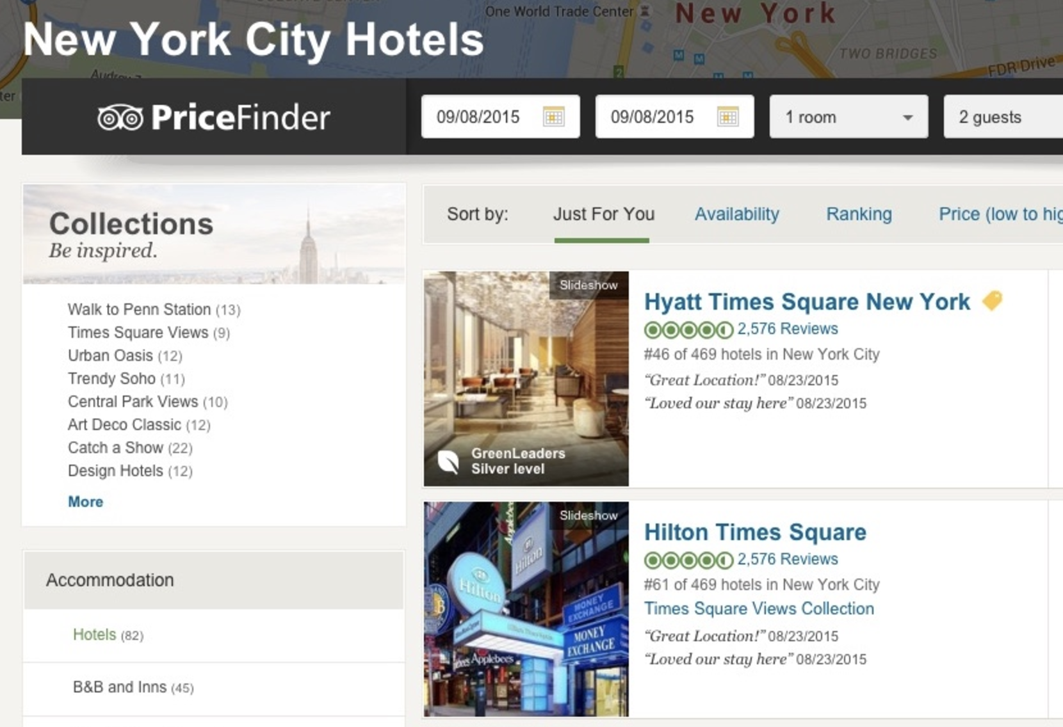
Example: Defining Hotel Collections from Reviews
Single Word + Topic Model:
The results are not very interesting
Goal: Grouping hotels based on structured facts extracted from the review text
http://engineering.tripadvisor.com/using-nlp-to-find-interesting-collections-of-hotels/

Slide 13
TripAdvisor: Using Phrase Mining to Help!
Quality Phrases
(automatically extracted)
Phrase Embedding + Clustering:
“Catch a Show” collection
“Near The High Line” collection
1 2 3 4 5 6 7 | broadway shows beacon theater broadway dance center broadway plays david letterman show radio city music hall theatre shows
1 2 3 4 5 6 7 | high line park chelsea market highline walkway elevated park meatpacking district west side old railway
Much more interesting!
http://engineering.tripadvisor.com/using-nlp-to-find-interesting-collections-of-hotels/

Slide 14
Outline
Why Mining Structures from Massive Text Data?
Text Preprocessing
Mining Quality Phrases: Motivation and Families of Methods
Supervised Approach
Unsupervised Approach (ToPMine)
Weakly Supervised Approach (SegPhrase)
Distantly Supervised Approach (AutoPhrase)
Summary

Slide 15
Supervised Phrase Mining
Phrase mining was originated from the NLP community
How to use linguistic analyzers to extract phrases?
Parsing (e.g., Stanford NLP parsers)
Noun Phrase (NP) Chunking
How to rank extracted phrases?
C-value [Frantzi et al.’00]
TextRank [Mihalcea et al.’04]
TF-IDF
Notes:
First, as the origin of the phrase mining, NLP community uses linguistic analyzers to extract phrases.
There are two widely-used analyzers: parser and chunker. We will introduce how to use them to extract phrases.
Since NLP tools can only extract the phrases without giving an explicit quality score, we need to further rank the extracted phrases. Here are three popular measurements: C-value, TextRank, and TF-IDF. We will introduce them one by one.

Slide 16
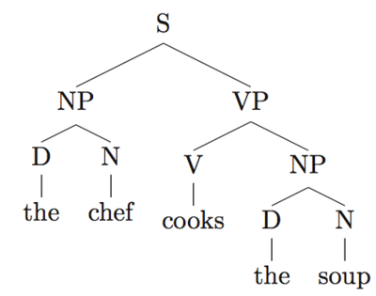
Linguistic Analyzer – Parsing
Minimal Grammatical Segments ⬄ Phrases
Phrases: “the chef”, “the soup”
Raw text sentence
(string)
Full-text Parsing
Full parse tree
(grammatical analysis)
The chef cooks the soup.
Notes:
Using parsers, we can get parsing trees for sentences.
Because phrases are the minimal semantic units, we can find the minimal NP, VP, …, depends on the application scenarios.
Here is a example, ....

Slide 17
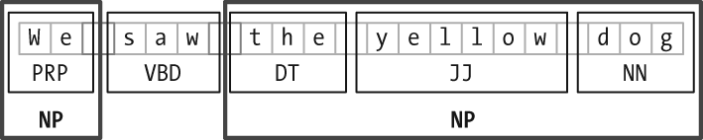
Linguistic Analyzer – Chunking
Noun phrase chunking is a light version of parsing
Apply tokenization and part-of-speech (POS) tagging to each sentence
Search for noun phrase chunks
Notes:
Another popular linguistic analyzer for phrase mining is noun phrase chunker. It is a light version of parsing.
As shown in the slide, the chunker can also return minimal noun phrase units.

Slide 18
Inefficiencies of Linguistic Analyzer
Difficult to directly apply pre-trained to new domains (e.g. twitter, biomedical, yelp)
Unless sophisticated, manually curated, domain-specific training data are provided
Computationally slow
Cannot be applied on web-scale data to support emerging applications
Lack of the usage of corpora-level information
NP sometimes cannot meet the requirements of quality phrases
We need “shallow” phrase mining techniques
Notes:
However, training a parser/chunker needs a lot of human effort and applying the pre-trained parsers to a new domain may hurt the performance a lot.
Another problem is the efficiency of parsing. It may not be a good choice for web-scale data to support emerging applications.
Besides, the noun phrases extraction didn’t take the corpus-level information into consideration. Therefore, some NPs are not quality phrases.
Therefore, we need to develop some “shallow” methods.

Slide 19
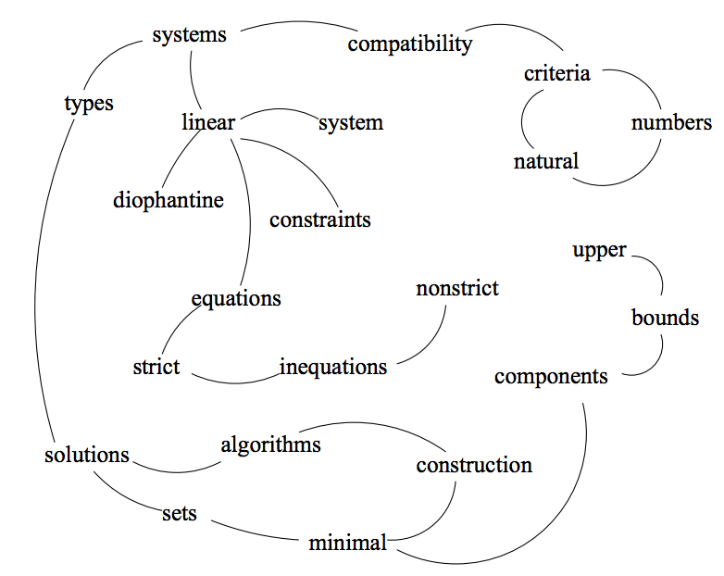
Ranking
C-Value
Prefers “maximal” phrases
Popularity & Completeness
TextRank
Similar to PageRank
Popularity & Informativeness
TF-IDF
Term Frequency
Inverse Document Frequency
Popularity & Informativeness
Compatibility of systems of linear constraints over the set of natural numbers. Criteria of compatibility of a system of linear Diophantine equations, strict inequations, and nonstrict inequations are considered. …..
Notes:
C-value only models the popularity and completeness
Another idea of ranking is to construct a network of phrases and run the TextRank, which is similar to the PageRank.
The importance score is usually large for those nodes of high-degree (i.e., popular phrases). And, the importance in the network is somehow similar to the informativeness in the corpus.
Therefore, we think it only models the popularity and the informativeness.
TF-IDF is well-known and widely used in IR models.
TF measures the popularity
IDF measures the informativeness

Slide 20
Mining Phrases: Why Not Use NLP Methods?
Phrase mining: Originated from the NLP community—“Chunking”
Model it as a sequence labeling problem (B-NP, I-NP, O, …)
Need annotation and training
Annotate hundreds of documents as training data
Train a supervised model based on part-of-speech features
Recent trend:
Use distributional features based on web n-grams (Bergsma et al., 2010)
State-of-the-art performance: ~95% accuracy, ~88% phrase-level F-score
Limitations
High annotation cost, not scalable to a new language, a new domain or genre
May not fit domain-specific, dynamic, emerging applications
Scientific domains, query logs, or social media, e.g., Yelp, Twitter

Slide 21
Outline
Why Mining Structures from Massive Text Data?
Text Preprocessing
Mining Quality Phrases: Motivation and Families of Methods
Supervised Approach
Unsupervised Approach (ToPMine)
Weakly Supervised Approach (SegPhrase)
Distantly Supervised Approach (AutoPhrase)
Summary

Slide 22
Unsupervised Phrase Mining
Statistics based on massive text corpora
Popularity
Raw frequency, or frequency distribution based on Zipfian ranks [Deane’05]
Concordance
Significance score [Church et al.’91][El-Kishky et al.’14]
Completeness
Comparison to super/sub-sequences [Parameswaran et al.’10]
Raw frequency could NOT reflect the quality of phrases
Combine with topic modeling
Merge adjacent unigrams of the same topic [Blei & Lafferty’09]
Frequent pattern mining within the same topic [Danilevsky et al.’14]
Limitations
Tokens in the same phrase may be assigned to different topics
E.g., knowledge discovery using least squares support vector machine classifiers…
Notes:
Unsupervised methods mainly use the statistical signals based on the input.
We categorize each signal based on which quality phrase criterion it models.

Slide 23
Various Strategies: Phrase-Based Topic Modeling
Strategy 1: Generate bag-of-words → generate sequence of tokens
Bigram topical model [Wallach’06], topical n-gram model [Wang, et al.’07], phrase discovering topic model [Lindsey, et al.’12]
Strategy 2: Post bag-of-words model inference, visualize topics with n-grams
Label topic [Mei et al.’07], TurboTopic [Blei & Lafferty’09], KERT [Danilevsky, et al.’14]
Strategy 3: Prior bag-of-words model inference, mine phrases and impose on the bag-of-words model
ToPMine [El-kishky, et al.’15]

Slide 24
Strategy 1: Simultaneously Inferring Phrases and Topics
Bigram Topic Model [Wallach’06]
Probabilistic generative model that conditions on previous word and topic when drawing next word
Topical N-Grams (TNG) [Wang, et al.’07]
Probabilistic model that generates words in textual order
Create n-grams by concatenating successive bigrams (a generalization of Bigram Topic Model)
Phrase-Discovering LDA (PDLDA) [Lindsey, et al.’12]
Viewing each sentence as a time-series of words, PDLDA posits that the generative parameter (topic) changes periodically
Each word is drawn based on previous m words (context) and current phrase topic
High model complexity: Tends to overfitting; High inference cost: Slow

Slide 25
Strategy 2: Post Topic Modeling Phrase Construction
TurboTopics [Blei & Lafferty’09] – Phrase construction as a post-processing step to Latent Dirichlet Allocation
Perform Latent Dirichlet Allocation on corpus to assign each token a topic label
Merge adjacent unigrams with the same topic label by a distribution-free permutation test on arbitrary-length back-off model
End recursive merging when all significant adjacent unigrams have been merged
KERT [Danilevsky et al.’14] – Phrase construction as a post-processing step to Latent Dirichlet Allocation
Perform frequent pattern mining on each topic
Perform phrase ranking based on four different criteria

Slide 26
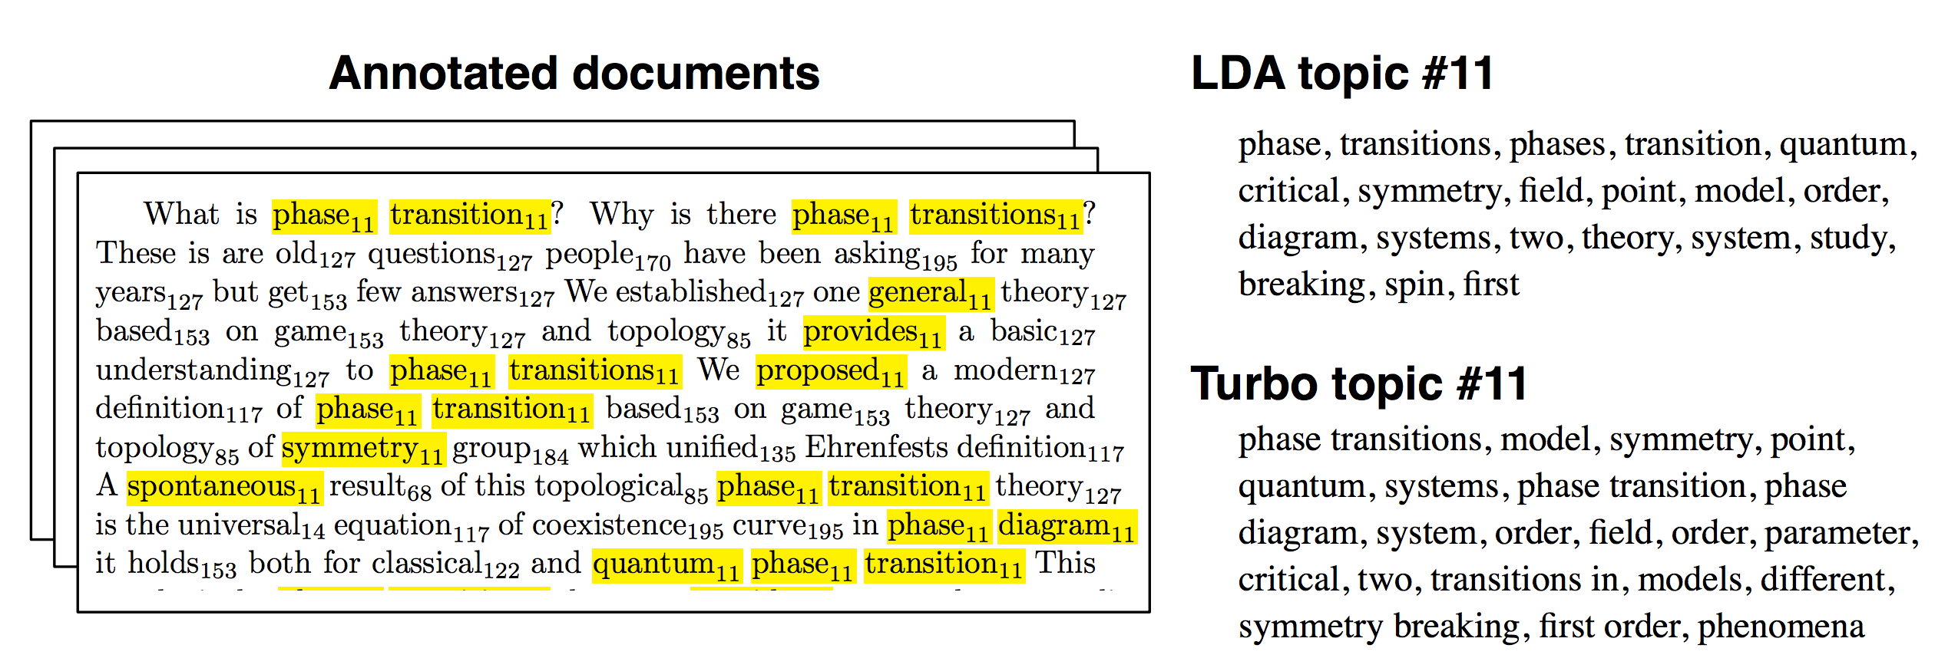
Example of TurboTopics
Perform LDA on corpus to assign each token a topic label
E.g., … phase₁₁ transition₁₁ …. game₁₅₃ theory₁₂₇ …
Then merge adjacent unigrams with same topic label

Slide 27
Our Recent Efforts on Phrase Mining
KERT (2014): Maria Danilevsky, Chi Wang, Nihit Desai, Xiang Ren, Jingyi Guo, and Jiawei Han. “Automatic Construction and Ranking of Topical Keyphrases on Collections of Short Documents“, SIAM Data Mining Conf. (SDM), 2014
ToPMine (2014-2015) Code package downloadable at http://elkishk2.web.engr.illinois.edu
Ahmed El-Kishky, Yanglei Song, Chi Wang, Clare R. Voss, and Jiawei Han, "Scalable Topical Phrase Mining from Text Corpora", 2015 Int. Conf. on Very Large Data Bases (VLDB'15)
SegPhrase (2015) GitHub Source: https://github.com/shangjingbo1226/SegPhrase
Jialu Liu, Jingbo Shang, Chi Wang, Xiang Ren, Jiawei Han, "Mining Quality Phrases from Massive Text Corpora", 2015 ACM SIGMOD Int. Conf. on Management of Data (SIGMOD'15)
Received Grand Prize of 2015 Yelp Data Set Challenge, used in industry, e.g., TripAdvisor, MSR, Google Research
AutoPhrase (2018) GitHub Source: https://github.com/shangjingbo1226/AutoPhrase
Jingbo Shang, Jialu Liu, Meng Jiang, Xiang Ren, Clare R. Voss, Jiawei Han, “AutoPhrase: Automated Phrase Mining from Massive Text Corpora”, TKDE, 2018
Our E-Book on Phrase Mining and Its Applications
Jialu Liu, Jingbo Shang, and Jiawei Han, Phrase Mining from Massive Text and Its Applications, Synthesis Lectures on Data Mining and Knowledge Discovery, Morgan & Claypool Publishers, 2017

Slide 28
KERT: Frequent Patterns + Ranking of KeyPhrases
KERT: Topical Keyphrase Extraction & Ranking [Danilevsky, et al. SDM 2014]
Run bag-of-words topic model inference and assign topic label to each token
Extract candidate keyphrases within each topic
Rank the keyphrases in each topic (Judging the quality of phrases)
Popularity: “information retrieval” vs. “cross-language information retrieval”
Discriminativeness: “this paper” (frequent but not discriminative, not informative)
Concordance: “powerful tea” vs. “strong tea”
Completeness: “vector machine” vs. “support vector machine”
Using frequent pattern mining
Comparability property: directly compare phrases of mixed lengths
Weakness: X First topic modeling, then finding candidate phrases! X
knowledge discovery using least squares support vector machine classifiers

Slide 29
Comparison of phrase ranking methods
KERT: Topical Phrases on Machine Learning
Top-Ranked Phrases by Mining Paper Titles in DBLP
kpRel [Zhao et al. 11] | KERT (-popularity) | KERT (-discriminativeness) | KERT (-concordance) | KERT [Danilevsky et al. 14]
learning | effective | support vector machines | learning | learning
classification | text | feature selection | classification | support vector machines
selection | probabilistic | reinforcement learning | selection | reinforcement learning
models | identification | conditional random fields | feature | feature selection
algorithm | mapping | constraint satisfaction | decision | conditional random fields
features | task | decision trees | bayesian | classification
decision | planning | dimensionality reduction | trees | decision trees
: | : | : | : | :
The topic that represents the area of Machine Learning

Slide 30
Strategy 3: First Phrase Mining then Topic Modeling
ToPMine [Ahmed El-Kishky, Yanglei Song, Chi Wang, Clare R. Voss, and Jiawei Han, "Scalable Topical Phrase Mining from Text Corpora", PVLDB 8(3): 305 - 316, 2015]
First phrase construction, then topic mining
Contrast with KERT: topic modeling, then phrase mining
The ToPMine Framework:
Perform frequent contiguous pattern mining to extract candidate phrases and their counts
Perform agglomerative merging of adjacent unigrams as guided by a significance score—This segments each document into a “bag-of-phrases”
The newly formed bag-of-phrases are passed as input to PhraseLDA, an extension of LDA, that constrains all words in a phrase to each sharing the same latent topic

Slide 31
Why First Phrase Mining then Topic Modeling ?
With Strategy 2, tokens in the same phrase may be assigned to different topics
Ex. knowledge discovery using least squares support vector machine classifiers…
Knowledge discovery and support vector machine should have coherent topic labels
Solution: switch the order of phrase mining and topic model inference
Techniques
Phrase mining and document segmentation
Topic model inference with phrase constraint
[knowledge discovery] using [least squares] [support vector machine] [classifiers] …
[knowledge discovery] using [least squares] [support vector machine] [classifiers] …

Slide 32
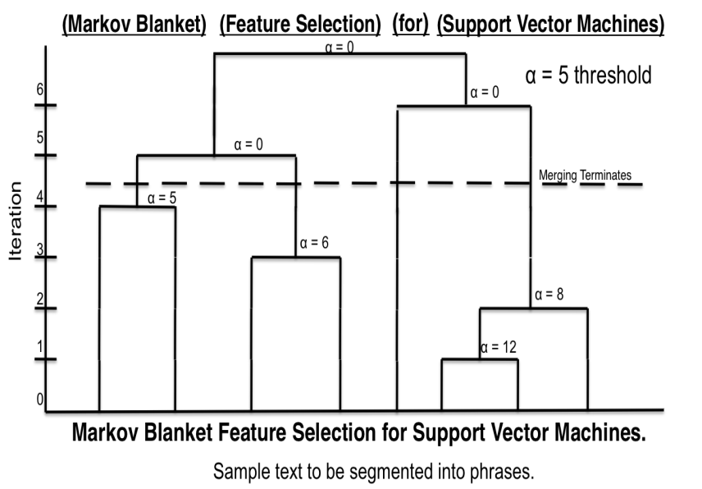
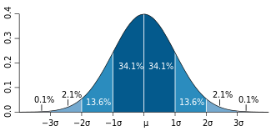
TopMine: First Mine Frequent Contiguous Patterns, Then Conduct Topic Modeling
First perform frequent contiguous pattern mining to extract candidate phrases and their counts
Quality phrases
Based on significance score [Church et al.’91]:
α(P₁, P₂) ≈ (f(P₁●P₂) ̶ µ₀(P₁,P₂))/√ f(P₁●P₂)
[Markov blanket] [feature selection] for [support vector machines]
[knowledge discovery] using [least squares] [support vector machine] [classifiers]
…[support vector] for [machine learning]…
Phrase | Raw freq. | True freq.
[support vector machine] | 90 | 80
[vector machine] | 95 | 0
[support vector] | 100 | 20
Rectify to real frequency by Phrasal Segmentation

Slide 33
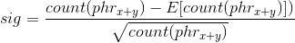
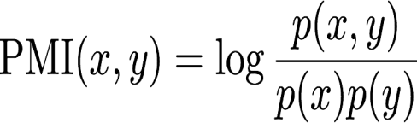
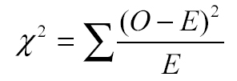
What Kind of Phrases Are of “High Quality”?
Popularity: Frequency
“information retrieval” vs. “cross-language information retrieval”
Concordance: A sequence of words that occur more frequently than expected
“powerful tea” vs. “strong tea”; “active learning” vs. “learning classification”
Informativeness
“this paper” (frequent but not discriminative, not informative)
Completeness
“vector machine” vs. “support vector machine”
Concordance can be measured using many statistical measures, e.g., significance score, mutual information, t-test, z-test, chi-squared test, likelihood ratio, …

Slide 34
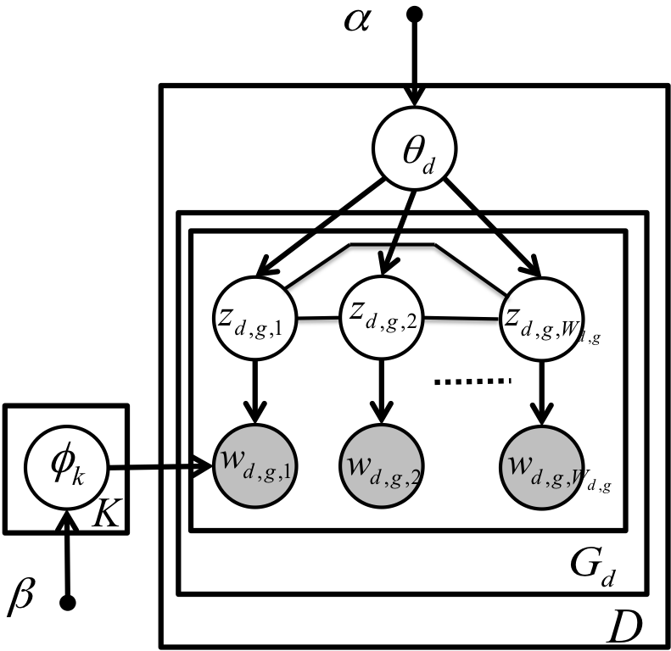
ToPMine: Phrase LDA (Constrained Topic Modeling)
The generative model for PhraseLDA is the same as LDA
Difference: the model incorporates constraints obtained from the “bag-of-phrases” input
Chain-graph shows that all words in a phrase are constrained to take on the same topic values
[knowledge discovery] using [least squares] [support vector machine] [classifiers] …
Topic model inference with phrase constraints

Slide 35
Example Topical Phrases: A Comparison
social networks | information retrieval
web search | text classification
time series | machine learning
search engine | support vector machines
management system | information extraction
real time | neural networks
decision trees | text categorization
: | :
Topic 1 | Topic 2
information retrieval | feature selection
social networks | machine learning
web search | semi supervised
search engine | large scale
information extraction | support vector machines
question answering | active learning
web pages | face recognition
: | :
Topic 1 | Topic 2
PDLDA [Lindsey et al. 12] Strategy 1 (3.72 hours)
ToPMine [El-kishky et al. 14]
Strategy 3 (67 seconds)
Notes:
An interesting comparison
A state of the art phrase-discovering topic model

Slide 36
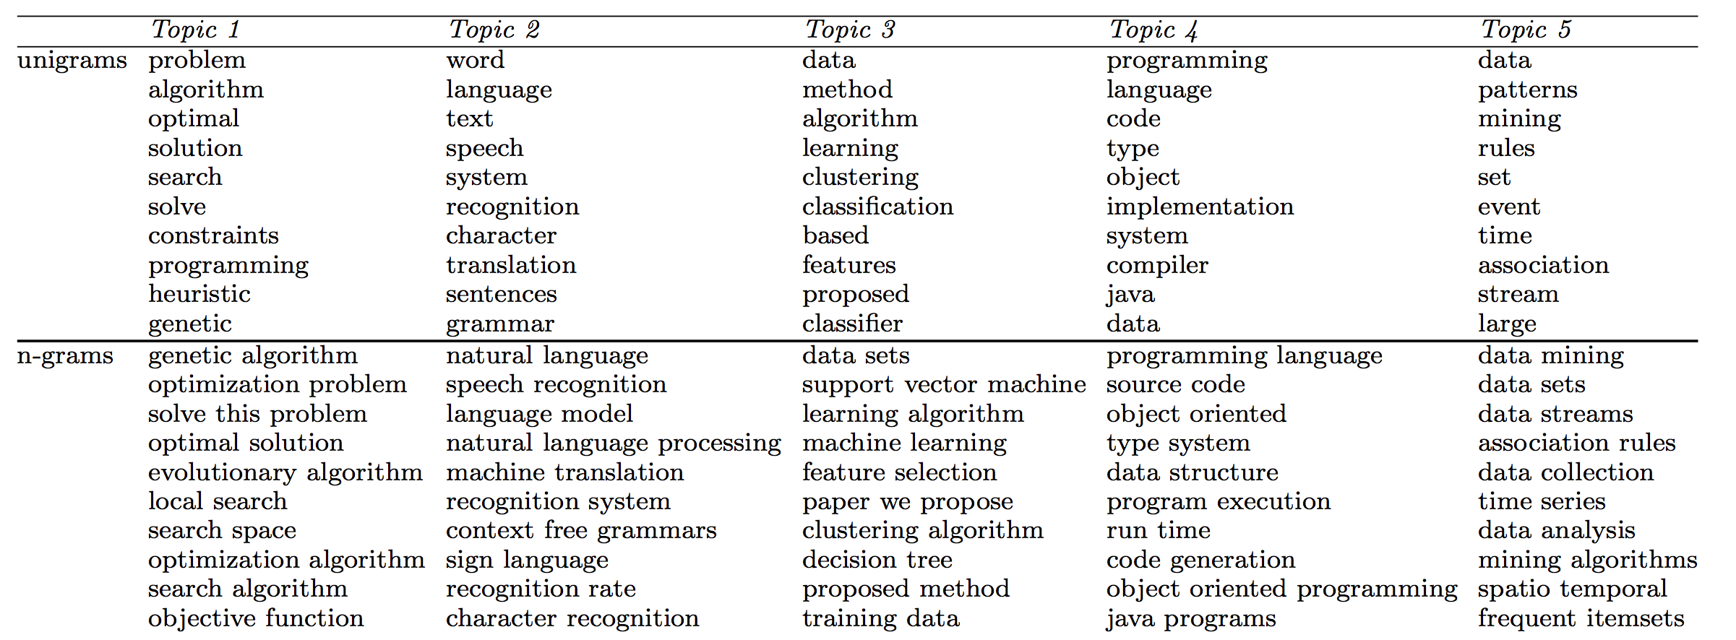
ToPMine: Experiments on DBLP Abstracts
Notes:
An interesting comparison
A state of the art phrase-discovering topic model

Slide 37
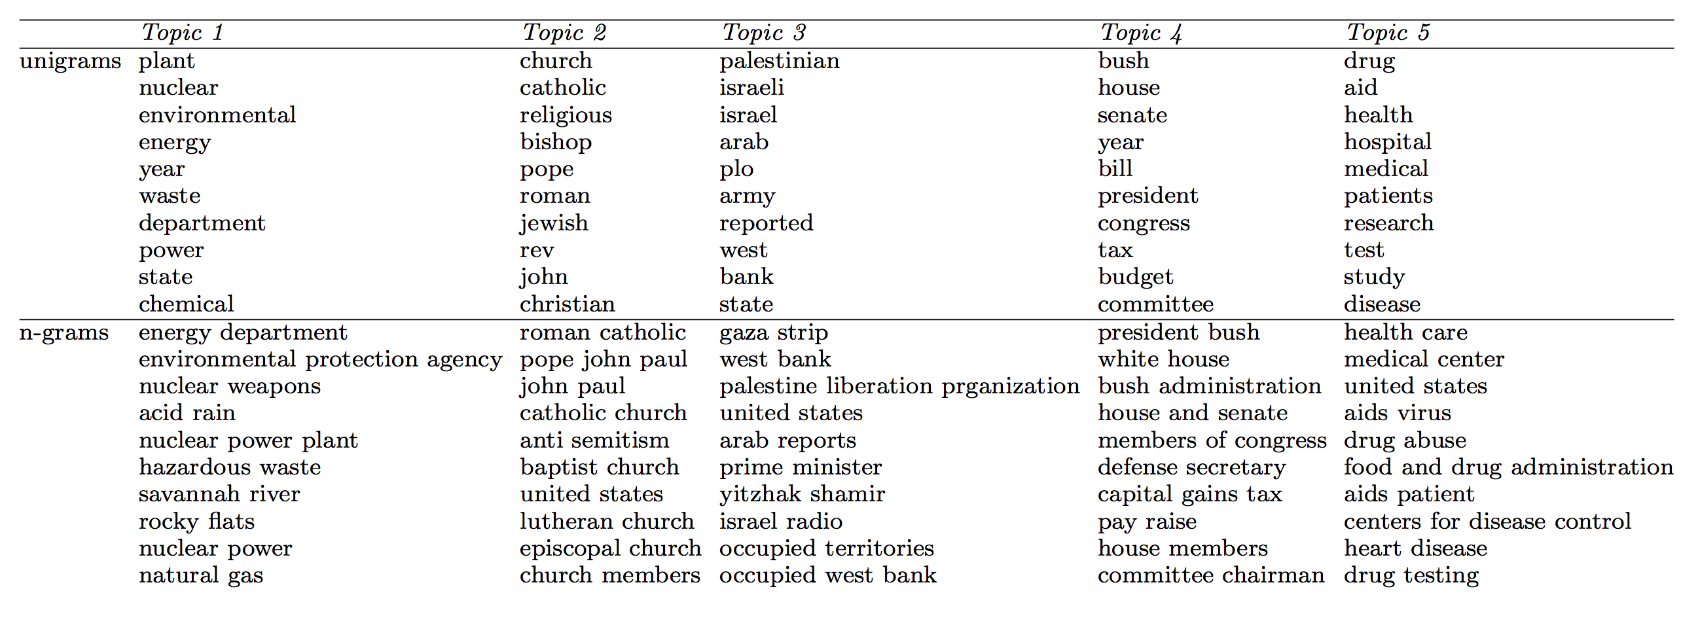
ToPMine: Topics on Associate Press News (1989)
Notes:
An interesting comparison
A state of the art phrase-discovering topic model

Slide 38
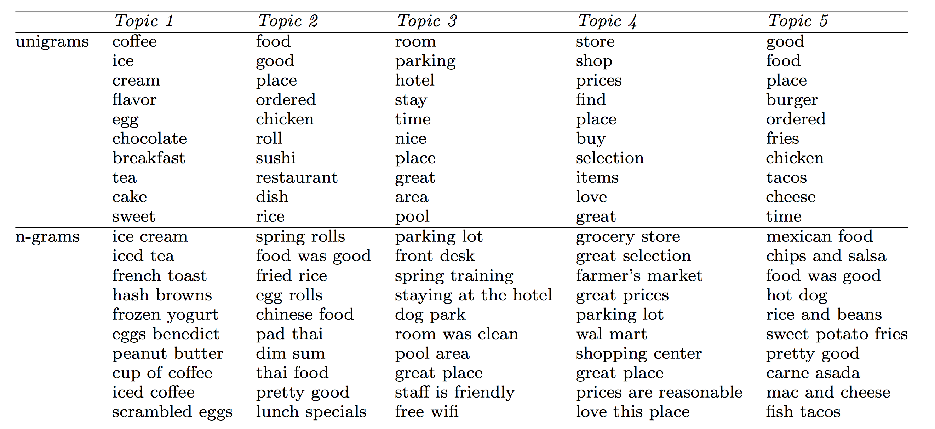
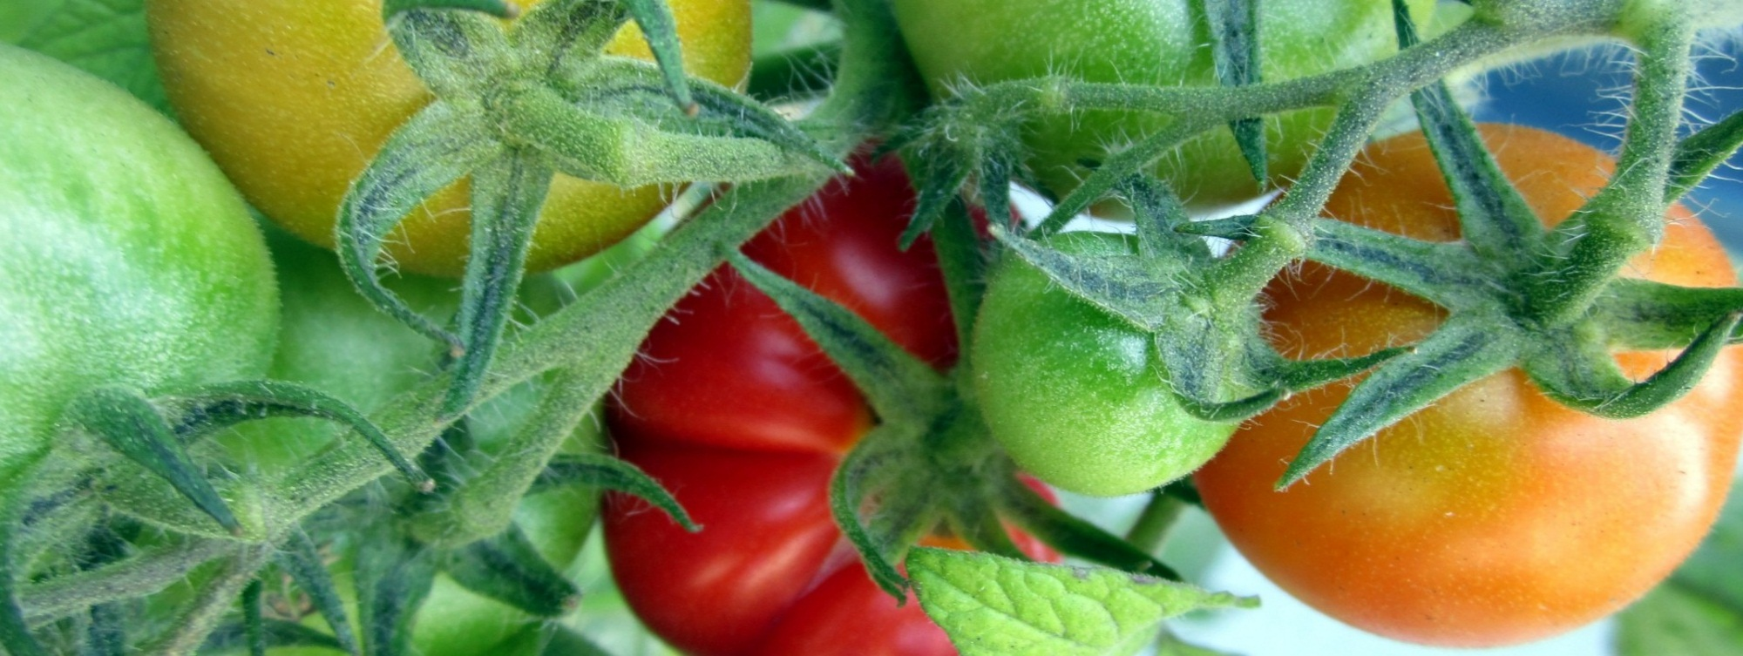
ToPMine: Experiments on Yelp Reviews
Notes:
An interesting comparison
A state of the art phrase-discovering topic model

Slide 39
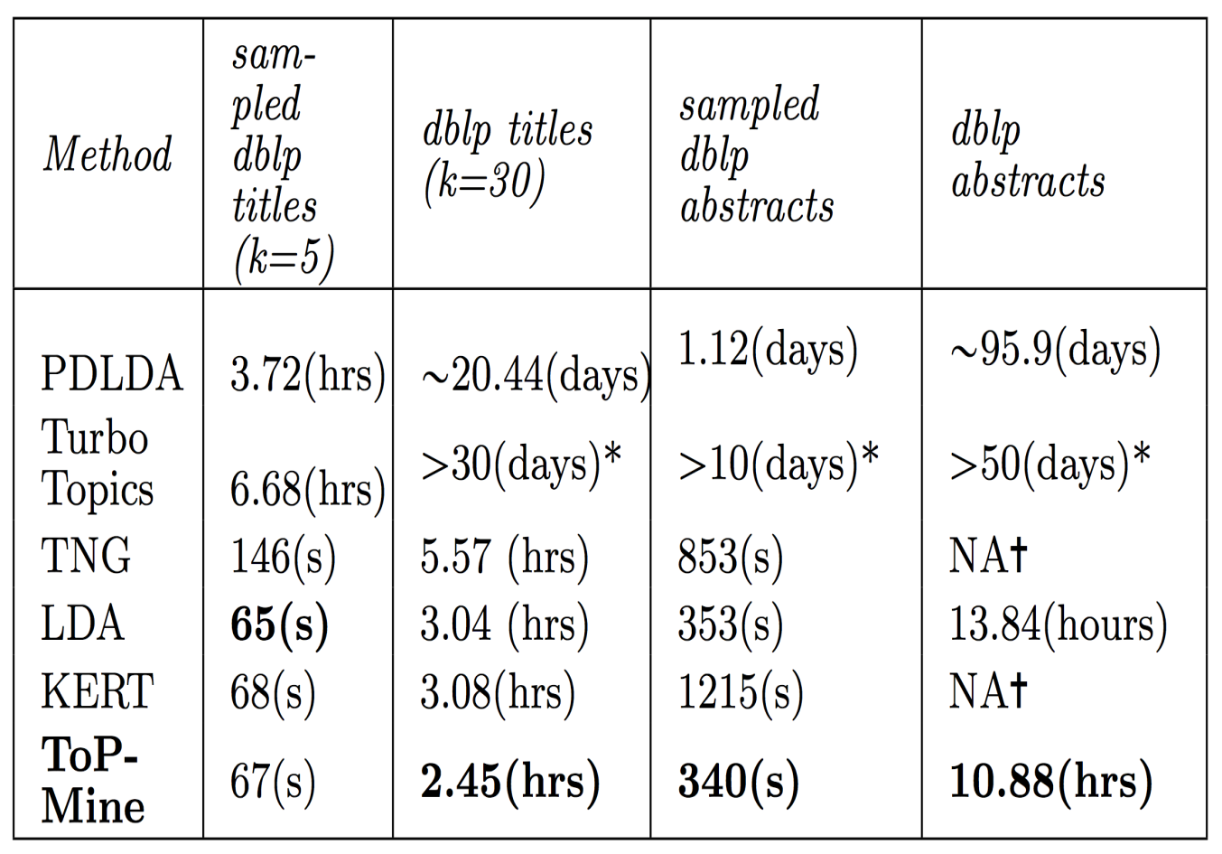
Efficiency: Running Time of Different Strategies
Running time: strategy 3 > strategy 2 > strategy 1 (“>” means outperforms)
Strategy 1: Generate bag-of-words → generate sequence of tokens
Strategy 2: Post bag-of-words model inference, visualize topics with n-grams
Strategy 3: Prior bag-of-words model inference, mine phrases and impose to the bag-of-words model

Slide 40
Coherence of Topics: Comparison of Strategies
Coherence measured by z-score: strategy 3 > strategy 2 > strategy 1
Strategy 1: Generate bag-of-words → generate sequence of tokens
Strategy 2: Post bag-of-words model inference, visualize topics with n-grams
Strategy 3: Prior bag-of-words model inference, mine phrases and impose to the bag-of-words model

Slide 41
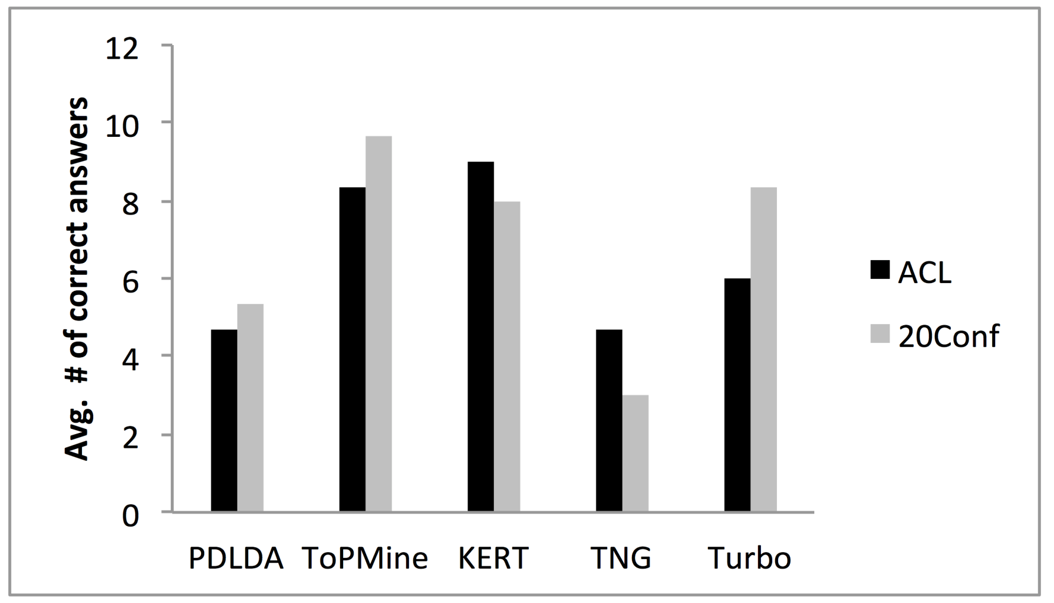
Phrase Intrusion: Comparison of Strategies
Phrase intrusion measured by average number of correct answers: strategy 3 > strategy 2 > strategy 1

Slide 42
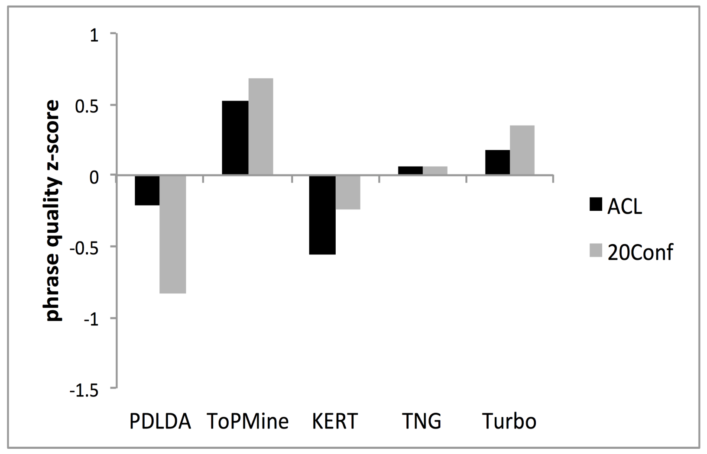
Phrase Quality: Comparison of Strategies
Phrase quality measured by z-score:
strategy 3 > strategy 2 > strategy 1

Slide 43
Difficulties: Comparison to Super/Sub-sequences
Frequency ratio between an n-gram phrase and its two (n-1)-gram phrases
Example
Pre-confidence of San Antonio: 2385 / 14585
Post-confidence of San Antonio: 2385 / 2855
Expand/terminate based on thresholds
Assumption
Counter-example
“relational database system” is a quality phrase
Both “relational database” and “database system” can be quality phrases
Phrase | Raw frequency
San | 14585
Antonio | 2855
San Antonio | 2385
An n-gram quality phrase
At least one of them is not a quality phrase
Two (n-1)-gram sub-phrases
Notes:
“Pre” means the first (n-1) tokens. In the example, it means “San Antonio” / “San”
“Post” means the last (n-1) tokens. In the example, it means “San Antonio” / “Antonio”
Start from unigrams, if both confidence scores are lower than the threshold, the expansion process terminates.

Slide 44
Limitations of Statistical Signals
The thresholds should be carefully chosen
Only consider a subset of quality phrase requirements
Combining different signals in an unsupervised manner is difficult
Introducing some supervision may help!
Notes:
For all unsupervised methods, there are some shared limitations.
(Listed in the slides)…

Slide 45
Outline
Why Mining Structures from Massive Text Data?
Text Preprocessing
Mining Quality Phrases: Motivation and Families of Methods
Supervised Approach
Unsupervised Approach (ToPMine)
Weakly Supervised Approach (SegPhrase)
Distantly Supervised Approach (AutoPhrase)
Summary

Slide 46
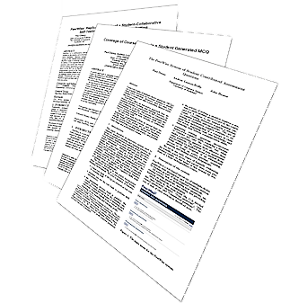
Phrase Mining: From Raw Corpus to Quality Phrases and Segmented Corpus
Raw Corpus
Quality Phrases
Segmented Corpus
Document 1
Citation recommendation is an interesting but challenging research problem in data mining area.
Document 2
In this study, we investigate the problem in the context of heterogeneous information networks using data mining technique.
Document 3
Principal Component Analysis is a linear dimensionality reduction technique commonly used in machine learning applications.
+ A small set of labels or a general KB
Input Raw Corpus
Quality Phrases
Segmented Corpus
Phrase Mining
Phrasal Segmentation
Integrating phrase mining with phrasal segmentation
TOPMINE: A. El-Kishky, et al., Scalable Topical Phrase Mining from Text Corpora”, in VLDB’15
SegPhrase: J. Liu et al., Mining Quality Phrases from Massive Text Corpora. SIGMOD’15 (Grand Prize in Yelp Dataset Challenge)
AutoPhrase: J. Shang, et al., Automated Phrase Mining from Massive Text Corpora, 2017 (submitted)

Slide 47
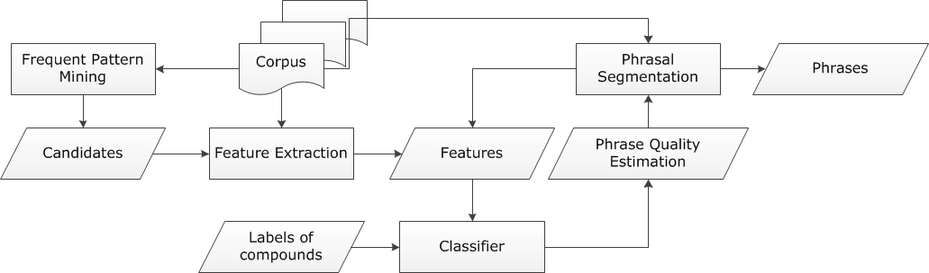
SegPhrase+: Exploring Training Data to Enhance Quality
SegPhrase (Classifier)
Small labeled dataset
Provided by experts
ClassPhrase
SegPhrase(+)
ClassPhrase: Frequent pattern mining, feature extraction, classification
SegPhrase: Phrasal segmentation and phrase quality estimation
SegPhrase+: One more round to enhance mined phrase quality

Slide 48
ClassPhrase I: Pattern Mining for Candidate Set
Build a candidate phrases set by frequent pattern mining
Mining frequent k-grams
k is typically small (e.g., 6 in our experiments)
Popularity measured by raw frequent words and phrases mined from the corpus

Slide 49
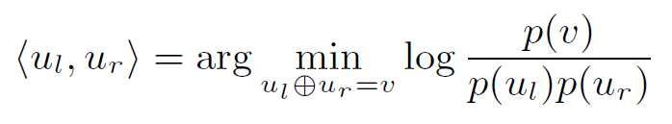
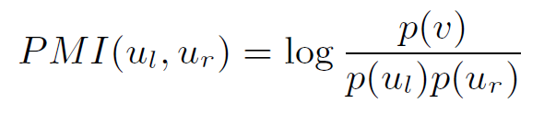
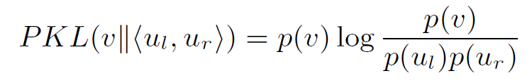
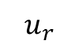
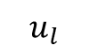
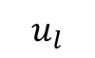
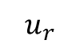
ClassPhrase II: Feature Extraction: Concordance
Partition a phrase into two parts to check whether the co-occurrence is significantly higher than pure random
support vector machine this paper demonstrates
Pointwise mutual information:
Pointwise KL divergence:
The additional p(v) is multiplied with pointwise mutual information, leading to less bias towards rare-occurred phrases
$$u_{l}$$
$$u_{r}$$
$$u_{l}$$
$$u_{r}$$

Slide 50
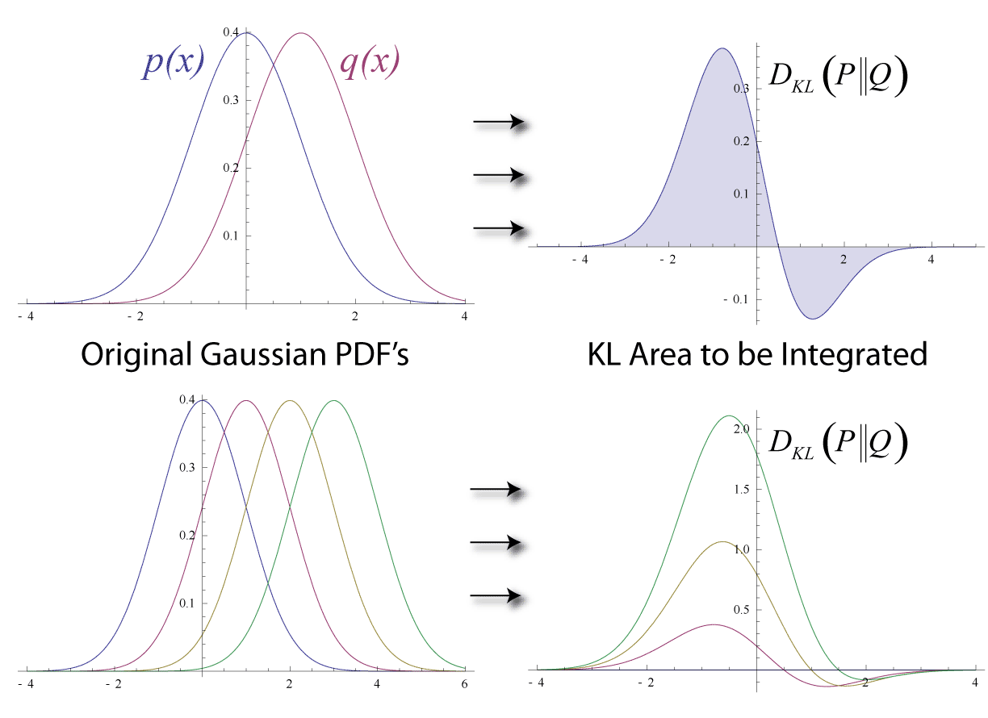
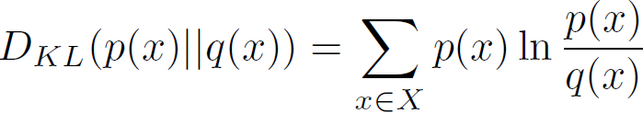
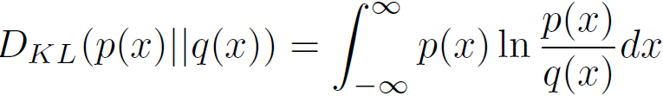
KL Divergence: Comparing Two Probability Distributions
Background knowledge from CS412
The Kullback-Leibler (KL) divergence: Measure the difference between two probability distributions over the same variable x
From information theory, closely related to relative entropy, information divergence, and information for discrimination
D_{KL}(p(x) || q(x)): divergence of q(x) from p(x), measuring the information lost when q(x) is used to approximate p(x)
Ack.: Wikipedia entry: The Kullback-Leibler (KL) divergence
Discrete form
Continuous form

Slide 51
ClassPhrase II: Feature Extraction: Informativeness
Deriving Informativeness
Quality phrases typically start and end with a non-stopword
“machine learning is” vs. “machine learning”
Use average IDF over words in the phrase to measure the semantics
Usually, the probabilities of a quality phrase in quotes, brackets, or connected by dash should be higher (punctuations information)
“state-of-the-art”
We can also incorporate features using some NLP techniques, such as POS tagging, chunking, and semantic parsing

Slide 52
ClassPhrase III: Classifier
Weakly Supervised
Labels: Whether a phrase is a quality one or not
“support vector machine”: 1
“the experiment shows”: 0
For ~1GB corpus, only 300 labels
Pros
Binary annotations are easy
Cons
The selection of hundreds of varying-quality phrases from millions of candidates should be careful
Random Forest as our classifier
Predicted phrase quality scores lie in [0, 1]
Bootstrap many different datasets from limited labels
Notes:
During the quality estimation step, SegPhrase requires a little supervision, …

Slide 53
Mining Phrases: Why Not Use Raw Frequency Based Methods?
Traditional data-driven approaches
Frequent pattern mining
If AB is frequent, likely AB could be a phrase
Raw frequency could NOT reflect the quality of phrases
E.g., frequency(vector machine) ≥ frequency(support vector machine)
Need to rectify the frequency based on segmentation results
Phrasal segmentation will tell
Some words should be treated as a whole phrase whereas others are still unigrams

Slide 54
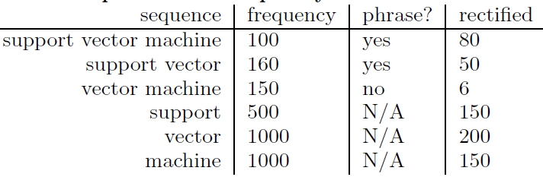
SegPhrase: Why Do We Need Phrasal Segmentation in Corpus?
Phrasal segmentation can tell which phrase is more appropriate
Ex: A standard [feature vector] [machine learning] setup is used to describe...
Rectified phrase frequency (expected influence)
Example:
Not counted towards the rectified frequency

Slide 55
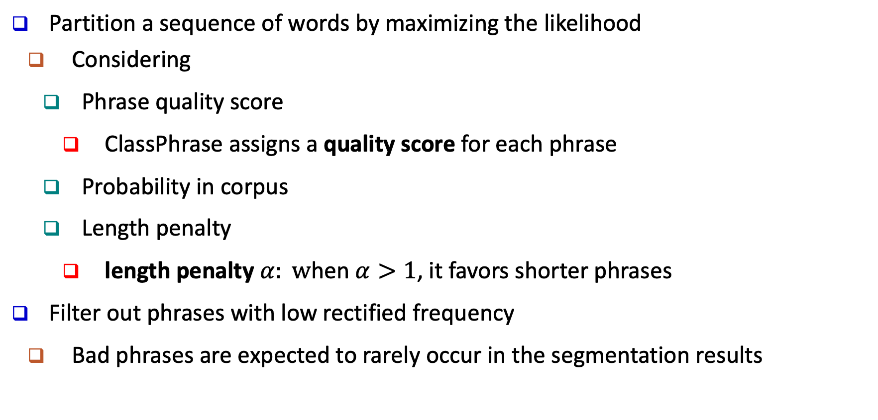
SegPhrase: Segmentation of Phrases
Partition a sequence of words by maximizing the likelihood
Considering
Phrase quality score
ClassPhrase assigns a quality score for each phrase
Probability in corpus
Length penalty
length penalty $α: w$hen $α>1$, it favors shorter phrases
Filter out phrases with low rectified frequency
Bad phrases are expected to rarely occur in the segmentation results

Slide 56
SegPhrase+: Enhancing Phrasal Segmentation
SegPhrase+: One more round for enhanced phrasal segmentation
Feedback
Using rectified frequency, re-compute those features previously computing based on raw frequency
Process
Classification → Phrasal segmentation // SegPhrase
Classification → Phrasal segmentation // SegPhrase+
Effects on computing quality scores
np hard in the strong sense
np hard in the strong
data base management system

Slide 57
Performance Study: Methods to Be Compared
Other phase mining methods: Methods to be compared
NLP chunking based methods
Chunks as candidates
Sorted by TF-IDF and C-value (K. Frantzi et al., 2000)
Unsupervised raw frequency based methods
ConExtr (A. Parameswaran, et al., VLDB 2010)
ToPMine (A. El-Kishky, et al., VLDB 2015)
Supervised method
KEA, designed for single document keyphrases (O. Medelyan & I. H. Witten, 2006)

Slide 58
Performance Study: Experimental Setting
Datasets
Popular Wiki Phrases
Based on internal links
~7K high quality phrases
Pooling
Sampled 500 * 7 Wiki-uncovered phrases
Evaluated by 3 reviewers independently
Dataset | #docs | #words | #labels
DBLP | 2.77M | 91.6M | 300
Yelp | 4.75M | 145.1M | 300

Slide 59
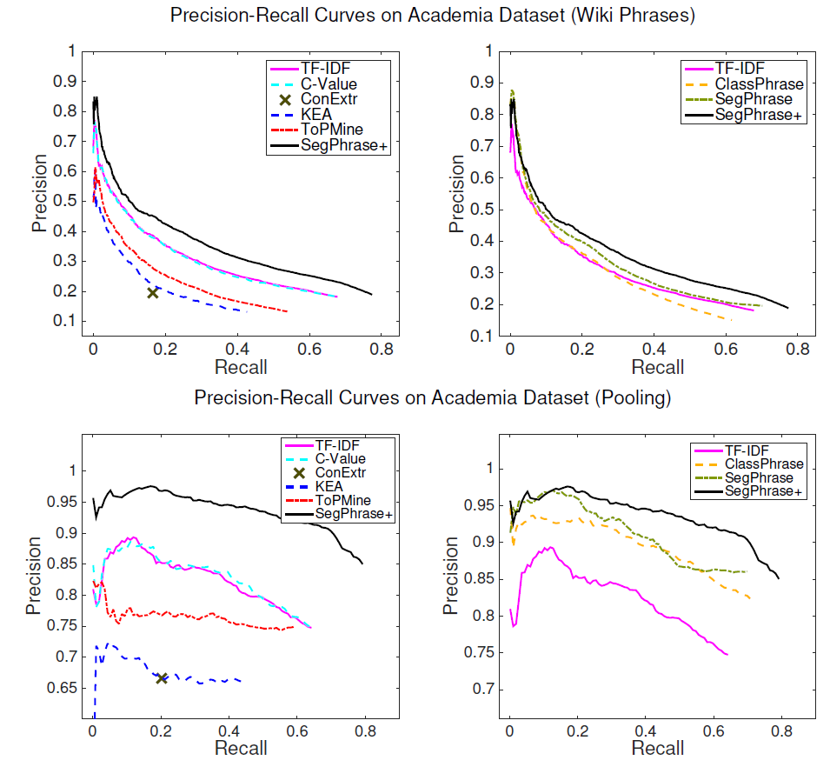
Performance: Precision Recall Curves on DBLP
Compare with other baselines
TF-IDF
C-Value
ConExtr
KEA
ToPMine
SegPhrase+
Compare with our 3 variations
TF-IDF
ClassPhrase
SegPhrase
SegPhrase+
59
Notes:
Then the picky audience might ask how to project phrase mining methods back to the corpus so we can get mention-level chunking results? Maybe during presentation we can emphasize that's not the goal, we think it's more interesting to discover important phrases from a large corpus without any manual annotations.

Slide 60
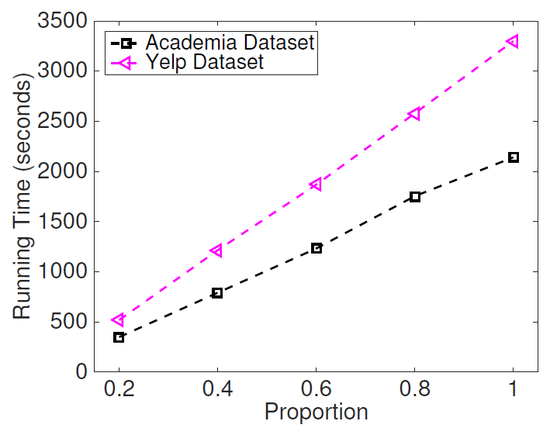
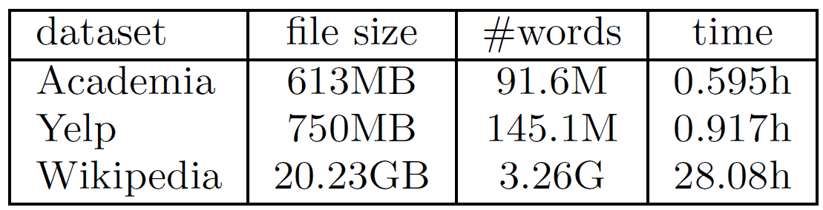
Performance Study: Processing Efficiency
SegPhrase+ is linear to the size of corpus!

Slide 61
Experimental Results: Interesting Phrases Generated (From the Titles and Abstracts of SIGMOD)
Query | SIGMOD
Method | SegPhrase+ | Chunking (TF-IDF & C-Value)
1 | data base | data base
2 | database system | database system
3 | relational database | query processing
4 | query optimization | query optimization
5 | query processing | relational database
… | … | …
51 | sql server | database technology
52 | relational data | database server
53 | data structure | large volume
54 | join query | performance study
55 | web service | web service
… | … | …
201 | high dimensional data | efficient implementation
202 | location based service | sensor network
203 | xml schema | large collection
204 | two phase locking | important issue
205 | deep web | frequent itemset
… | … | …
Only in SegPhrase+
Only in Chunking

Slide 62
Experimental Results: Interesting Phrases Generated (From the Titles and Abstracts of SIGKDD)
Query | SIGKDD
Method | SegPhrase+ | Chunking (TF-IDF & C-Value)
1 | data mining | data mining
2 | data set | association rule
3 | association rule | knowledge discovery
4 | knowledge discovery | frequent itemset
5 | time series | decision tree
… | … | …
51 | association rule mining | search space
52 | rule set | domain knowledge
53 | concept drift | importnant problem
54 | knowledge acquisition | concurrency control
55 | gene expression data | conceptual graph
… | … | …
201 | web content | optimal solution
202 | frequent subgraph | semantic relationship
203 | intrusion detection | effective way
204 | categorical attribute | space complexity
205 | user preference | small set
… | … | …
Only in SegPhrase+
Only in Chunking

Slide 63
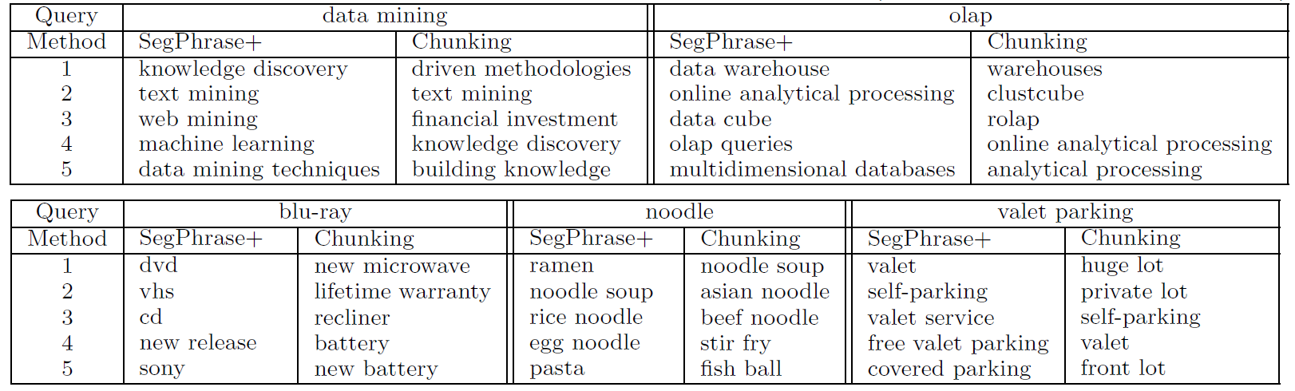
Experimental Results: Similarity Search
Find high-quality similar phrases based on user’s phrase query
In response to a user’s phrase query, SegPhrase+ generates high quality, semantically similar phrases
In DBLP, query on “data mining” and “OLAP”
In Yelp, query on “blu-ray”, “noodle”, and “valet parking”

Slide 64
Mining Quality Phrases in Multiple Languages
Both ToPMine and SegPhrase+ are extensible to mining quality phrases in multiple languages
SegPhrase+ on Chinese (From Chinese Wikipedia)
ToPMine on Arabic (From Quran (Fus7a Arabic)(no preprocessing)
Experimental results of Arabic phrases:
كفروا → Those who disbelieve
بسم الله الرحمن الرحيم→ In the name of God the Gracious and Merciful
Rank | Phrase | In English
… | … | …
62 | 首席_执行官 | CEO
63 | 中间_偏右 | Middle-right
… | … | …
84 | 百度_百科 | Baidu Pedia
85 | 热带_气旋 | Tropical cyclone
86 | 中国科学院_院士 | Fellow of Chinese Academy of Sciences
… | … | …
1001 | 十大_中文_金曲 | Top-10 Chinese Songs
1002 | 全球_资讯网 | Global News Website
1003 | 天一阁_藏_明代_科举_录_选刊 | A Chinese book name
… | … | …
9934 | 国家_戏剧_院 | National Theater
9935 | 谢谢_你 | Thank you
… | … | …

Slide 65
Outline
Why Mining Structures from Massive Text Data?
Text Preprocessing
Mining Quality Phrases: Motivation and Families of Methods
Supervised Approach
Unsupervised Approach (ToPMine)
Weakly Supervised Approach (SegPhrase)
Distantly Supervised Approach (AutoPhrase)
Summary

Slide 66
AutoPhrase: Automated Phrase Mining
Jingbo Shang, Jialu Liu, Meng Jiang, Xiang Ren, Clare R. Voss, Jiawei Han, “AutoPhrase: Automated Phrase Mining from Massive Text Corpora” submitted for pub. 2017
Automatic extraction of high-quality phrases (e.g., scientific terms and general entity names) in a given corpus (e.g., research papers and news)
No human efforts
Multiple languages
High performance—precision, recall, efficiency

Slide 67
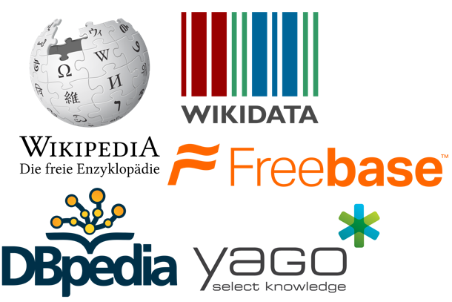
Definition: “Automatic”
Automatic ⬄ Minimal Human Effort
Using only existing general knowledge bases without any other human effort
Number of Wikipedia articles
That’s it?
Problem solved?
Everything can be found in KBs?
Entity names, High-quality Phrases
Rapidly growing!
Freely available!
Common knowledge
Life sciences
Art …
https://en.wikipedia.org/wiki/Wikipedia:Size_of_Wikipedia

Slide 68
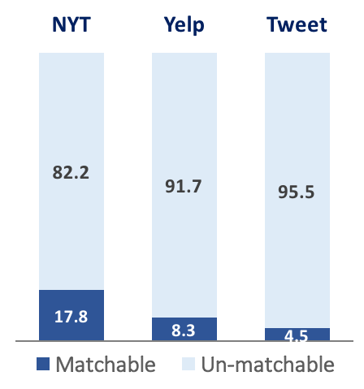
Challenge: “Un-matchable” is Dominating!
“matchable” entities, high-quaity phrases, …
Example: entity types
Text corpus
(Ren et al., KDD’15)
Knowledge Bases
Reasons
Incomplete knowledge bases
Low-confidence matching
“Un-matchable”
(Mintz et al., 2009) , (Riedek et al., 2010), (Lin et al., 2012), (Ling et al., 2012),
(Surdeanu et al., 2012), (Xu et al., 2013), (Nagesh et al., 2014), …

Slide 69
AutoPhrase: Label Generation by Distant Supervision
Completely remove the human effort for labeling phrases
Distant training: Utilize high-quality phrases in KBs (e.g., Wiki) as positive phrase labels
Method: Sampling-based label generation
Positive Labels
Wikipedia contains many high-quality phrases in titles, keywords, and internal links
E.g., in Chinese, more than 20,000
Uniformly draw 100 samples as positive labels for single-word and multi-word phrases respectively
Negative Labels
Phrase candidates meeting the popularity requirement is huge in size and the majority of them are actually poor in quality (e.g., “francisco opera and”).
Ex. A small corpus in Chinese has about 4 million frequent phrase candidates, while more than 90% are not in good quality

Slide 70
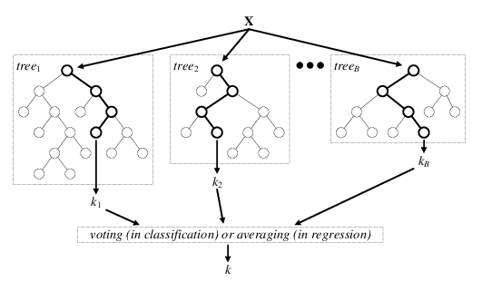
Random Forest: Basic Concept
Background knowledge from CS412
Random Forest (first proposed by L. Breiman in 2001)
A variation of bagging for decision trees
Data bagging
Use a subset of training data
by sampling with replacement for each tree
Feature bagging
At each node use a random selection of attributes as candidates and split by the best attribute among them
Comparing with original bagging, the random forests method increases the diversity among generated trees
During classification, each tree votes and the most popular class is returned

Slide 71
Robust Positive-Only Distant Training
In each base classifier, randomly sample K positive (e.g., wiki titles, keywords, links) and K noisy negative labels from the pools
Noisy negative pool: δ quality phrases among the K negative labels
Perturbed training set: size-2K subset of the full set of all phrase where the labels of some quality phrases are switched from positive to negative
For each base classifier, we randomly draw K phrase candidates with replacement from the positive pool and the negative pool respectively
We grow an unpruned decision tree to the point of separating all phrases to meet this requirement
Use an ensemble classifier that averages the results of T independently trained base classifiers

Slide 72
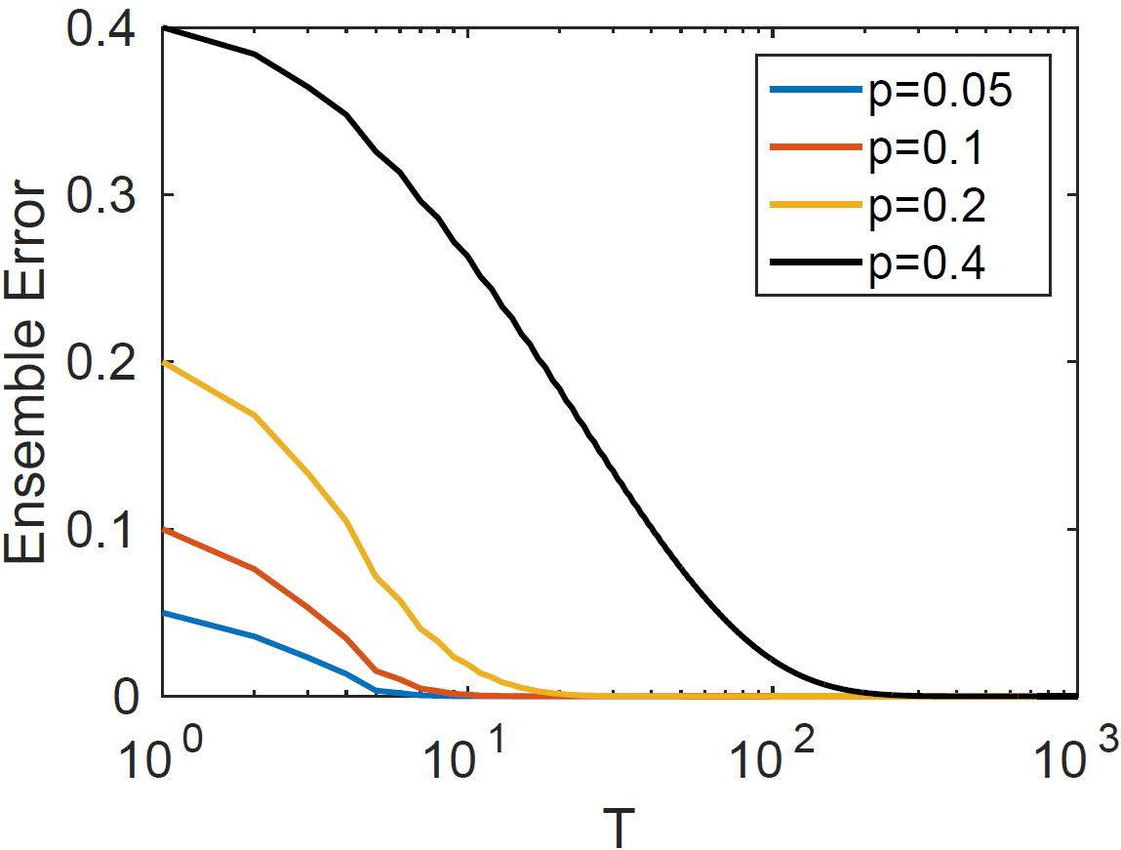
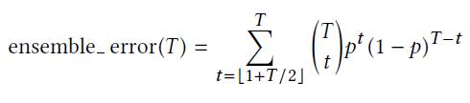
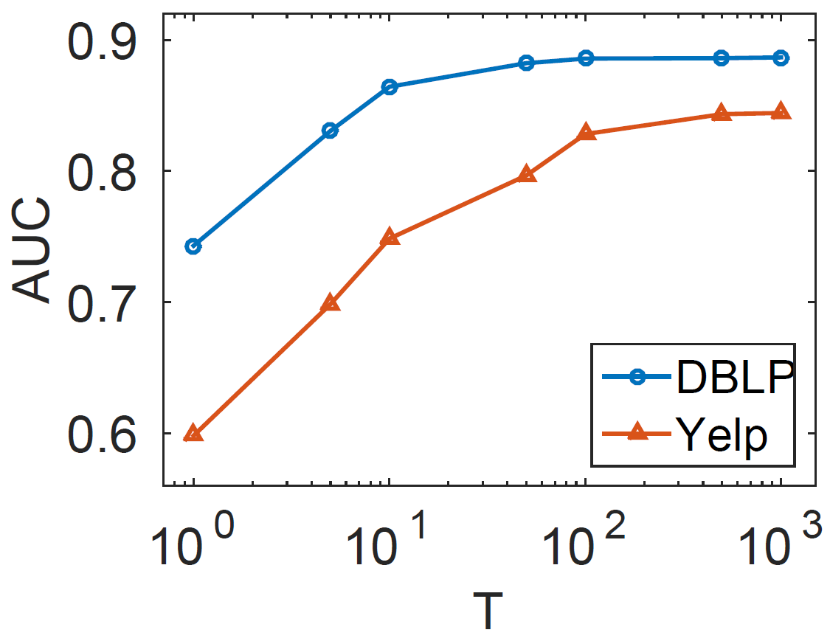
Is this idea robust?
Theoretical Analysis
T base classifiers
Exponentially decreasing
Empirical Performance
AUC to evaluate the ranking
There is also model error

Slide 73
Empirical Evaluation: Precision Recall Curve
Output: a ranked list of phrases with decreasing quality
Evaluation Process
Output Results
… data mining machine learning information retrieval np hard in a strong sense … support vector machine np hard in a strong …
Evaluation Results
… 1 1 1 1 … 1 0 …
Scientific Papers
Domain Experts
Compute precision & recall at each rank
Notes:
In phrase mining, our output is a ranked list.
So we recruit domain experts to evaluate whether a phrase is a high-quality phrase or not.
For example, the phrase “np hard in a strong” will be marked as 0.
During the evaluation process, the experts are encouraged to use search engines like Google to better understand those phrases they are not very familiar with.
Based on the expert evaluation results, we can compute precision and recall at every rank.
And then we plot the precision-recall curve. In an ideal ranking result, the precision-recall curve should look like this.
In our evaluation, we mainly look at the area under the precision-recall curve.
The bigger the area is, the better the result is.

Slide 74
Datasets and Compared Methods
Datasets:
Comparing methods
SegPhrase/WrapSegPhrae (encoding preprocessing for handling non-English)
TF-IDF/TextRank
Metric: Precision Recall Curves

Slide 75
AutoPhrase: Cross-Domain Evaluation Results
Computer Science Papers
Yelp Business Reviews
Wikipedia Articles
SegPhrase (SIGMOD’15): Outperformed TopMine (VLDB’15) and many other methods
TF-IDF: Stanford NLP Parser (LREC’16) + Ranked by TF-IDF
TextRank (ACL’04): Stanford NLP Parser (LREC’16) + Ranked by TextRank
Notes:
As we mentioned in the introduction, our methods are designed to be effective in multiple domains and languages.
We first evaluate the results in three domains: CS papers, Yelp reviews, and Wiki articles.
We mainly compared AutoPhrase with SegPhrase and Stanford NLP Parser.
SegPhrase has outperformed many unsupervised methods like TopMine. So we didn’t include the results here.
The Stanford NLP parser can extract noun phrases and verb phrases from sentences.
We use the popular TF-IDF and TextRank to rank the extracted phrases.
TF-IDF is a popular measurement in information retrieval. TF is term frequency and IDF is the inverse document frequency.
TextRank is similar to the PageRank. We construct a graph of phrases and build edges as their co-occurrence within a given sliding window. Then we run the random walk on this graph and compute the page rank.
As you can see here, AutoPhrase always has the best performance.
The compared methods include
AutoPhrase: distantly supervised
SegPhrase: weakly supervised (outperformed ToPMine, ConExtr, KEA, NLP-based + ranking, …)
NLP-based methods + TF-IDF/TextRank ranking

Slide 76
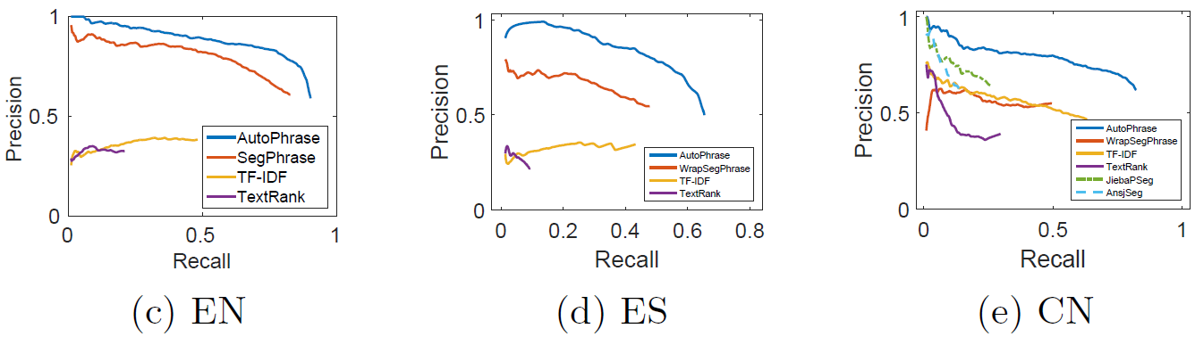
AutoPhrase: Cross-Language Evaluation Results
English
Spanish
Chinese
WrapSegPhrase: non-English characters → English letters & SegPhrase
JiebaSeg: Specifically for Chinese; Dictionaries & Hidden Markov Models
AnsjSeg: Specifically for Chinese; Dictionaries & Conditional Random Fields
Notes:
We further conducted experiments in different languages.
Since SegPhrase is originally designed for English, we introduce its variant WrapSegPhrase for other languages.
We encode the non-English tokens using English letters. The first token is marked as ‘a’, the second as ‘b’, and so on.
I would like to highlight here, on the Chinese dataset, we compare with the popular, supervised Chinese phrase mining methods, Jieba Segmentation and Ansj Segmentation. They are using conditional random fields and hidden markov models trained on annotated corpora.
As you can see here, AutoPhrase performs the best.
Compared Methods:
WrapSegPhrase: encoding/decoding process for non-English languages + SegPhrase
NLP-based methods + TF-IDF/TextRank ranking
Pre-trained Chinese Segmenters: AnsjSeg and JiebaPSeg

Slide 77
AutoPhrase: Example Results
Corpora = Wikipedia articles
English (EN) & Chinese (CN)
808.0M & 371.9M words
Positive pool sizes
184K & 29K
Mined Quality Phrases (>0.5)
345K & 116K
Notes:
We can see in the very long-tail part, we still have high-quality phrases
Settings
Corpora = Wikipedia articles
English (EN) & Chinese (CN)
808.0M & 371.9M words
Positive pool sizes
184K & 29K
Mined Quality Phrases (>0.5)
345K & 116K

Slide 78
Distant Training Exploration
4 pools
EP means that domain experts give the positive pool
DP means that a sampled subset from existing general knowledge bases forms the positive pool
EN means that domain experts give the negative pool
DN means that all unlabeled (i.e., not in the positive pool) phrase candidates form the negative pool
Combining any pair of one positive and one negative, we have 4 variants
2 cases:
When we have enough labels in EP
After we exhaust labels in EP

Slide 79
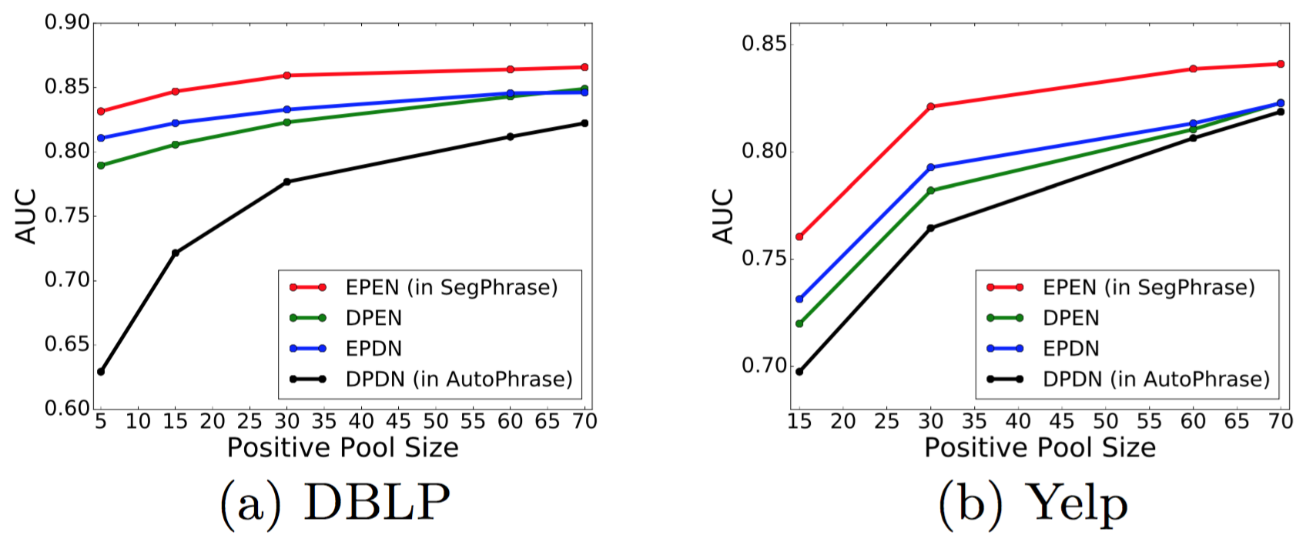
Case 1: When Having Enough Labels in EP
EPEN vs. DPEN: The positive labels from knowledge bases have reasonable quality
EPEN vs. EPDN: The noise in negative labels has been successfully reduced
EPEN vs. DPDN: Well-designed human labels are better

Slide 80
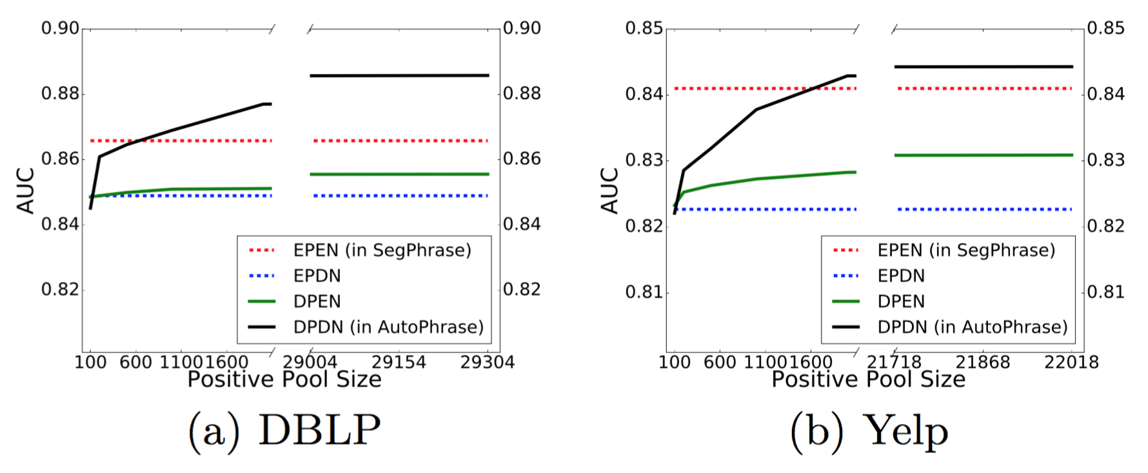
Case 2: After Exhausting Labels in EP
EPEN vs. DPDN: The distant training can finally beat domain experts when positive pool sizes become large enough
Our guess is that the tipping point is proportional to the number of words
Notes:
(e.g., 91.6M in DBLP and 145.1M in Yelp).

Slide 81
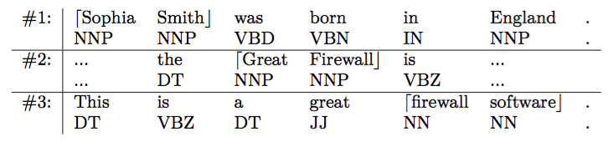
Generating High-Quality Phrases in Multi-Languages
Complicated pre-processing models, such as dependency parsing, heavily rely on human efforts and thus cannot be smoothly applied to multiple languages
Minimum Language Dependency = Tokenization + POS tagging
Drawbacks of Frequency-based signals only: Over-decomposition & Under-decomposition
“Sophia Smith” vs. “Sophia” and “Smith”
“Great Firewall” vs. “firewall software”
Drawbacks of POS only:
“classifier SVM” vs. “discriminative classifier” and “SVM”
Context-aware phrasal segmentation

Slide 82
Single-Word Modeling: Enhancing Recall
AutoPhrase: Simultaneously model single-word and multi-word phrases
A phrase is not only a group of multiple words, but also possibly a single word, as long as it functions as a constituent in the syntax of a sentence, e.g., “UIUC”, “Illinois”
Based on our experiments: 10%~30% quality phrases are single-word phrases
Modeling single-word phrases: Examining requirements of quality multi-word phrase
Popularity: sufficient frequent in the given corpus
Concordance: the collocation of tokens in such frequency that is significantly higher than random
Informativeness: indicative of a specific topic or concept
Completeness: Complete semantic unit
Only concordance cannot be defined in single-word phrases
Independence: A quality single-word phrase is more likely a complete semantic unit in the given documents

Slide 83

Importance of Being Aware of POS tags
POS tags help AutoPhrase perform much better than SegPhrase on non-English languages (e.g., Chinese)

Slide 84
Outline
Why Mining Structures from Massive Text Data?
Text Preprocessing
Mining Quality Phrases: Motivation and Families of Methods
Supervised Approach
Unsupervised Approach (ToPMine)
Weakly Supervised Approach (SegPhrase)
Distantly Supervised Approach (AutoPhrase)
Summary

Slide 85
Summary
Mining quality phrases is important for many text-intensive applications
High quality information extraction, typing, taxonomy construction and other text mining tasks
Families of methods
Supervised Approach
Unsupervised Approach (ToPMine)
Weakly Supervised Approach (SegPhrase)
Distantly Supervised Approach (AutoPhrase)
It is critical to promote develop weakly/distantly supervised approaches

Slide 86
References
Blei, D.M. and Lafferty, J.D., 2009. Topic models. Text mining: classification, clustering, and applications, 10(71), p.34
D. M. Blei and J. D. Lafferty. Visualizing Topics with Multi-Word Expressions, arXiv:0907.1013, 2009
Church, K., Gale, W., Hanks, P. and Hindle, D., 1991. Using statistics in lexical analysis. Lexical acquisition: exploiting on-line resources to build a lexicon, 115, p.164.
M. Danilevsky, C. Wang, N. Desai, X. Ren, J. Guo, J. Han. Automatic Construction and Ranking of Topical Keyphrases on Collections of Short Documents“, SDM’14
Deane, P., 2005, A nonparametric method for extraction of candidate phrasal terms. In Proc. ACL, pp. 605-613
Ahmed El-Kishky, Yanglei Song, Chi Wang, Clare R. Voss, and Jiawei Han, "Scalable Topical Phrase Mining from Text Corpora", PVLDB 8(3): 305 - 316, 2015
Evans, D.A. and Zhai, C., 1996. Noun-phrase analysis in unrestricted text for information retrieval. In Proc. ACL, pp. 17-24
K. Frantzi, S. Ananiadou, and H. Mima, Automatic Recognition of Multi-Word Terms: the c-value/nc-value Method. Int. Journal on Digital Libraries, 3(2), 2000
Koo, T., Carreras Pérez, X. and Collins, M., 2008. Simple semi-supervised dependency parsing. In Proc. ACL, pp. 595-603
R. V. Lindsey, W. P. Headden, III, M. J. Stipicevic. A phrase-discovering topic model using hierarchical pitman-yor processes, EMNLP-CoNLL’12.
Jialu Liu, Jingbo Shang, Chi Wang, Xiang Ren, Jiawei Han, "Mining Quality Phrases from Massive Text Corpora", in Proc. of 2015 ACM SIGMOD Int. Conf. on Management of Data (SIGMOD'15), Melbourne, Australia, May 2015
Jialu Liu, Jingbo Shang, and Jiawei Han, Phrase Mining from Massive Text and Its Applications, Morgan & Claypool Publishers, 2017.

Slide 87
References (Continued)
Liu, Z., Chen, X., Zheng, Y. and Sun, M., 2011, June. Automatic keyphrase extraction by bridging vocabulary gap. In Proceedings of the Fifteenth Conference on Computational Natural Language Learning (pp. 135-144)
O. Medelyan and I. H. Witten, Thesaurus Based Automatic Keyphrase Indexing. IJCDL’06
Q. Mei, X. Shen, C. Zhai. Automatic Labeling of Multinomial Topic Models, KDD’07
Mihalcea, R. and Tarau, P., 2004. TextRank: Bringing order into texts. Association for Computational Linguistics.
A. Parameswaran, H. Garcia-Molina, and A. Rajaraman. Towards the Web of Concepts: Extracting Concepts from Large Datasets. VLDB’2010
Park, Y., Byrd, R.J. and Boguraev, B.K., 2002. Automatic glossary extraction: beyond terminology identification. In Proceedings of the 19th international conference on Computational linguistics-Volume 1 (pp. 1-7)
Jingbo Shang, Jialu Liu, Meng Jiang, Xiang Ren, Clare R Voss, Jiawei Han, "Automated Phrase Mining from Massive Text Corpora", IEEE Transactions on Knowledge and Data Engineering, 30(10):1825-1837 (2018)
Witten, I.H., Paynter, G.W., Frank, E., Gutwin, C. and Nevill-Manning, C.G., 1999. KEA: Practical automatic keyphrase extraction. In Proceedings of the fourth ACM conference on Digital libraries (pp. 254-255). ACM.
Xun, E., Huang, C. and Zhou, M., 2000. A unified statistical model for the identification of English baseNP. In Proceedings of the 38th Annual Meeting on Association for Computational Linguistics (pp. 109-116).
X. Wang, A. McCallum, X. Wei. Topical n-grams: Phrase and topic discovery, with an application to information retrieval, ICDM’07
Zhang, Z., Iria, J., Brewster, C. and Ciravegna, F., 2008. A comparative evaluation of term recognition algorithms. In LREC.

